Slide 1
Q. What does Rotary have in common with…

Slide 2



Slide 3



Slide 4



Slide 5
A. Plenty of hookups, but not too many long-term relationships.

Slide 6
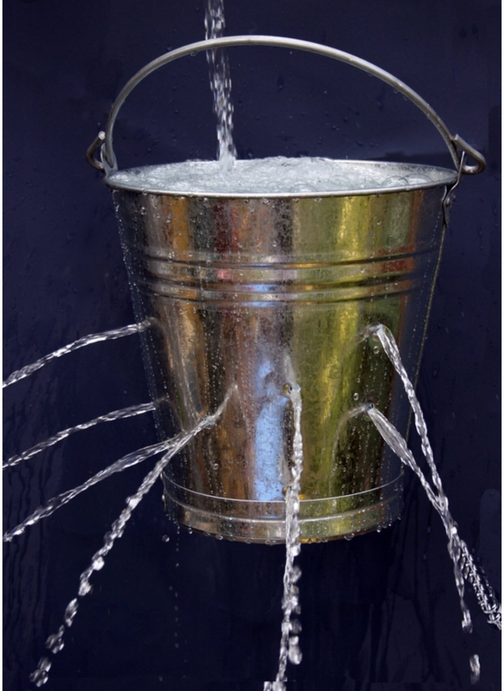

Slide 7

Leadership must first and foremost meet the needs of others.
Robert K. Greenleaf.

Slide 8
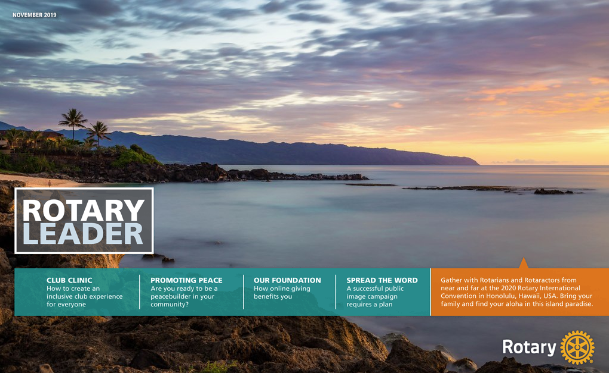

Slide 9
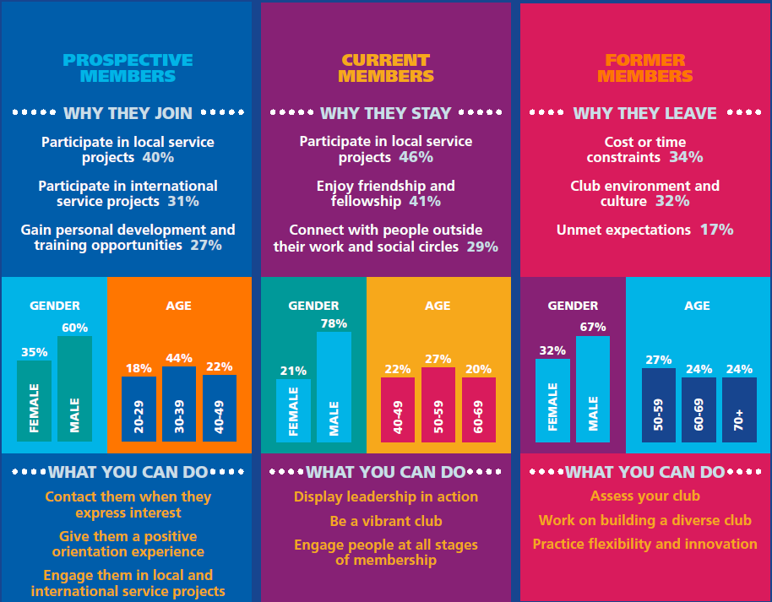

Slide 10

Why do people leave Rotary?
Uncontrollables
Controllables
Reasons we cannot control.
Extrinsic to club.
Reasons we can control.
Intrinsic to club.
Sometimes referred to as PULL factors.
Sometimes referred to as PUSH factors.

Slide 11
Uncontrollables
We CAN use members’ time more productively.
Competing time commitments
Competing financial obligations
We CAN reduce
the cost burden
of membership.
Personal challenges:
Death
Illness / Poor Health
We CAN still
show we care.
Trauma / Tragedy
Retrenchment
We CAN work more proactively to keep them in Rotary.
Relocation

Slide 12
Uncontrollables
Controllables
Competing time commitments
Unmet needs / expectations
Competing financial obligations
Poor engagement
Personal challenges:
Poor leadership or direction
Death
Undervalued / unappreciated
Illness / Poor Health
Conflict
Trauma / Tragedy
Uneven workload distribution
Retrenchment
Poor communication
Relocation
Poor change management

Slide 13
Controllables
How well are you
Controlling the Controllables?
Unmet needs / expectations
Poor engagement
Poor leadership or direction
How would you know which of these are issues in your club?
Undervalued / unappreciated
Conflict
Uneven workload distribution
You have to ask!
Poor communication
Poor change management

Slide 14


Slide 15
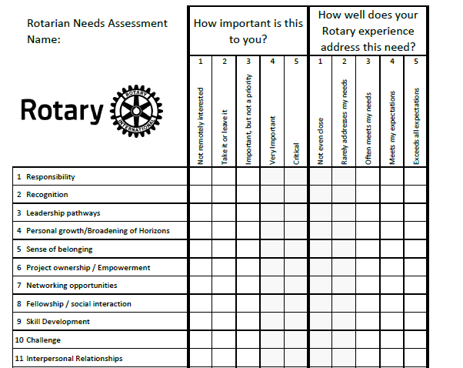


Slide 17

What can we learn from this exercise?

Slide 18

Goals are the fuel in the furnace of achievement.
Brian Tracy

Slide 19

External Goals
Internal Goals
Projects
Causes
Events
Fundraisers
Projects
Causes
Events
Fundraisers
Processes
Membership
Culture
Training & Development
Member Wellbeing
Helping others achieve their Goals

