Slide 1
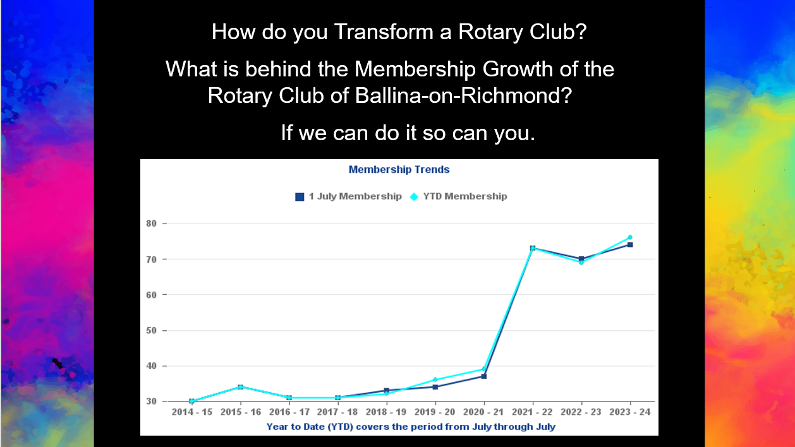
Notes:
From 2019 to 2021 our club grew from 33 to 76 members. In June this year we had 88 members.

Slide 2

Integrity
Making a difference and contributing to causes and needs both locally and globally.
Golf Day
Fellowship
DIK
RAWCS Re-cycle Reuse
Gala Dinner
Breakfast
Club
Homeless
Hot Meal
Centre
Domestic Violence Advocacy and Education
Love Bites Education Program
Youth
Programs
Bowls Day
Service
Polio Plus Rotary Foundation
Day’s for Girls Birthing Kits
Employee
Recognition
Flood Support
Mental Health
Duck Race
Diversity
Richmond Room/Sign
Leadership

Slide 3
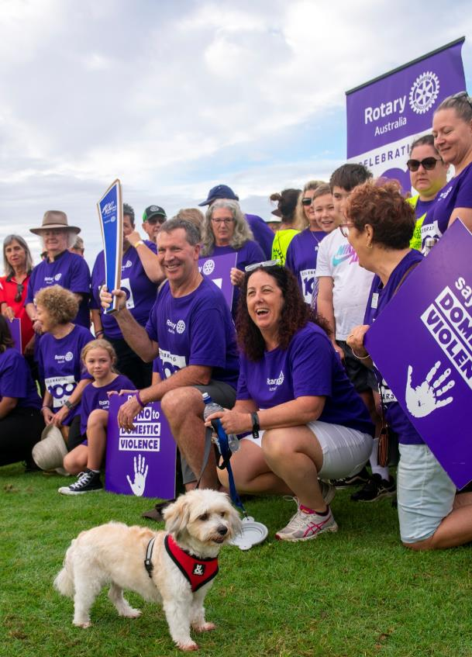
It always seems impossible until it's done.
- Nelson Mandela
Established “Core Business’ Objectives”
FOCUS ON LOCAL CAUSES
ENGAGE COMMUNITY
ATTRACTIVE & RELEVANT CLUB
ENGAGING EDUCATIONAL MEETINGS
STRONG COMMUNITY PROFILE
USE FACEBOOK & INSTAGRAM
80% EFFORT TO CORE OBJECTIVES
Notes:
Projects/Projects/Projects=Service/Service/Service Apex No.1 Ideal was ‘Make Service the Basis of all Enterprise’ Rotary has 5 Avenues of Service, Club Service, Vocational Service, Community Service, International Service and New Generation Service.
Rotary Brand is easy to sell like Toyota/Honda, trusted reliable. How do you sell your brand to your community. You need to connect with your town with a project or projects that have purpose, meaning and make a difference. Then you need to sell it.

Slide 4


Domestic and Family
Violence Project
We have a 2 stage approach to DV
1. Raise awareness & advocate against DV
2. Educate Youth about Respectful Relationships
Notes:
Many Rotary clubs already active in supporting the cause of Domestic Violence. We encourage clubs that are to continue with their great work. This may include providing support for those experiencing of fleeing domestic and family violence. This campaign is directly linked to the federal governments ‘stop it at the start campaign’ after much consultation with both government and non-government agencies it was widely agreed that Rotary could best make a positive impact in the area of D&FV by Raising Awareness and advocating against D&FV and providing support with the delivery of Respectful Relationship programs is schools such as the ‘Love Bites’ program. NAPCAN (National association for the Prevention of Childhood Abuse and Neglect) has partnered with Rotary to help influence positive change in attitudes and behaviours that support gender based violence. This is a primary prevention approach

Slide 5

What did we do?
We began knocking on doors. Talked and had conversations with professional & volunteers that work in the area of DV.
What did they think we could do to help?
We formed relationships with:
Police, Health, Local Primary and High Schools, Local Council,
Service Providers, Women's Groups like Zonta, CWA, Inner Wheel,
Local DV committees, State and Federal Members,
Salvation Army, St Vincent De Paul and more.
Notes:
Please refer to the Tool Kit for support material

Slide 6
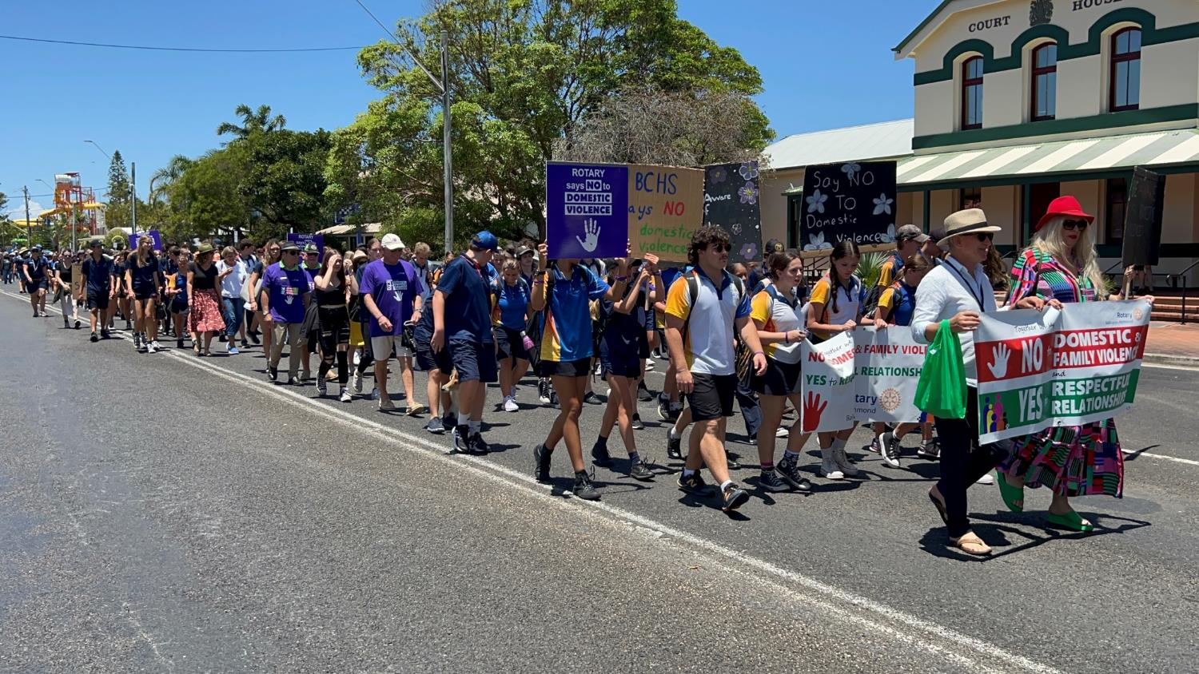
My Story in ‘Creating Hope in the World’
Notes:
In 2018 I (Dave Harmon) attended a funeral service for a friends sister that was stabbed to death in front of her 3 young children and the house set on fire. At this time I was the incoming president of the Rotary club of Ballina on Richmond and I remember thinking to myself at the funeral ‘this is just crazy what is happening with regard to D&FV and what could I do as incoming president of our club to make our town a safer place for women and children?’
I discussed this with our new club board and we began our project/campaign against D&FV

Slide 7
Video has been removed to keep file size down. Please see https://vimeo.com/1021141006 for video

Slide 8
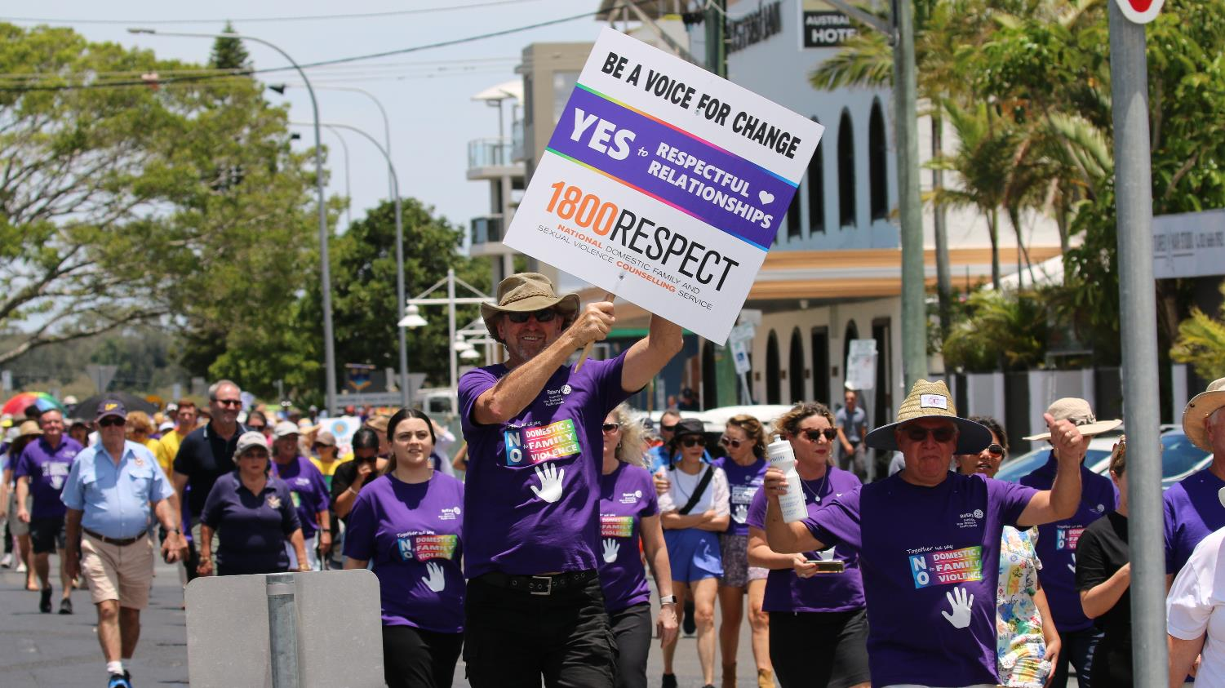
Notes:
Our Ballina walk down the main street last year

Slide 9
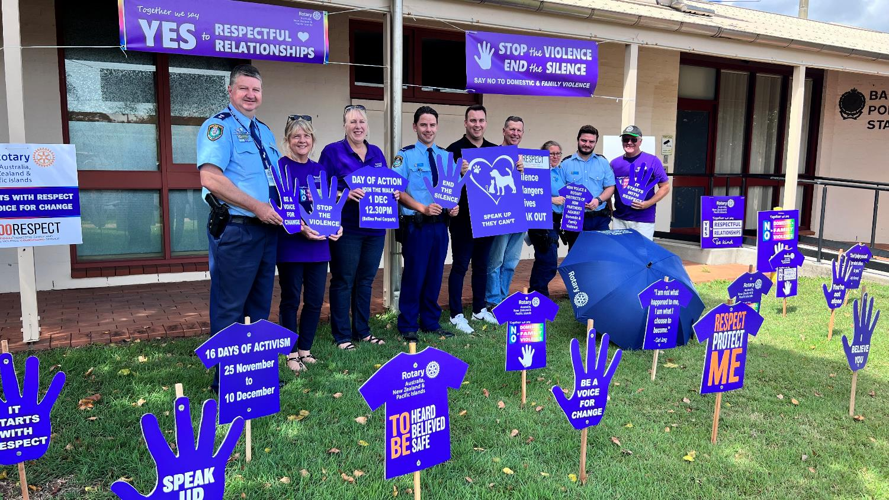
Notes:
We have both formal and informal partnerships formed with various state Police. In NSW we have a 3 year partnership with the NSW Police force. This is the result of the relationship formed with our local superintendent Mr Scott Tanner who has worked very closely with our Rotary clubs campaign. Mr Tanner invited me to attend Police Head office in Sydney and present a partnership proposal to NSW Police. This proposal was unanimously supported. This partnership main area of focus is for both parties to combine our resources and activate an activity during the international 16 days of activism against gender based violence from 25 Nov – 10th Dec. This photo shows the signage we have at the front entrance of Ballina Police station during the 16days of activism

Slide 10
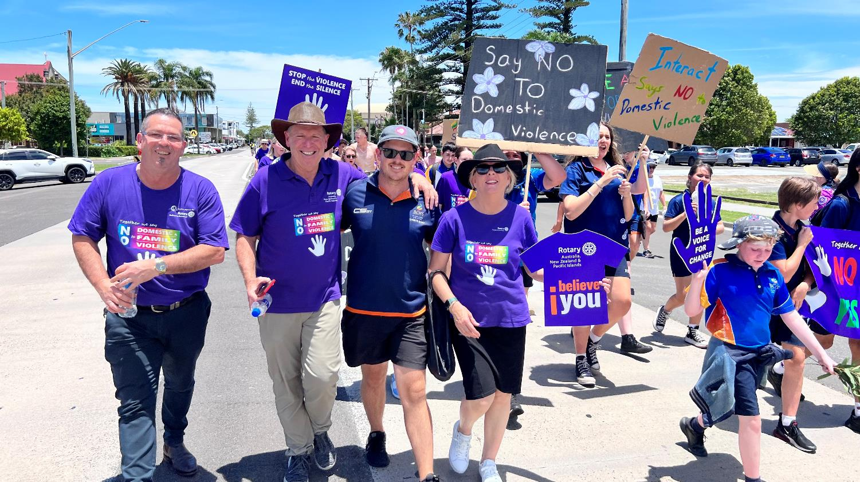

Slide 11
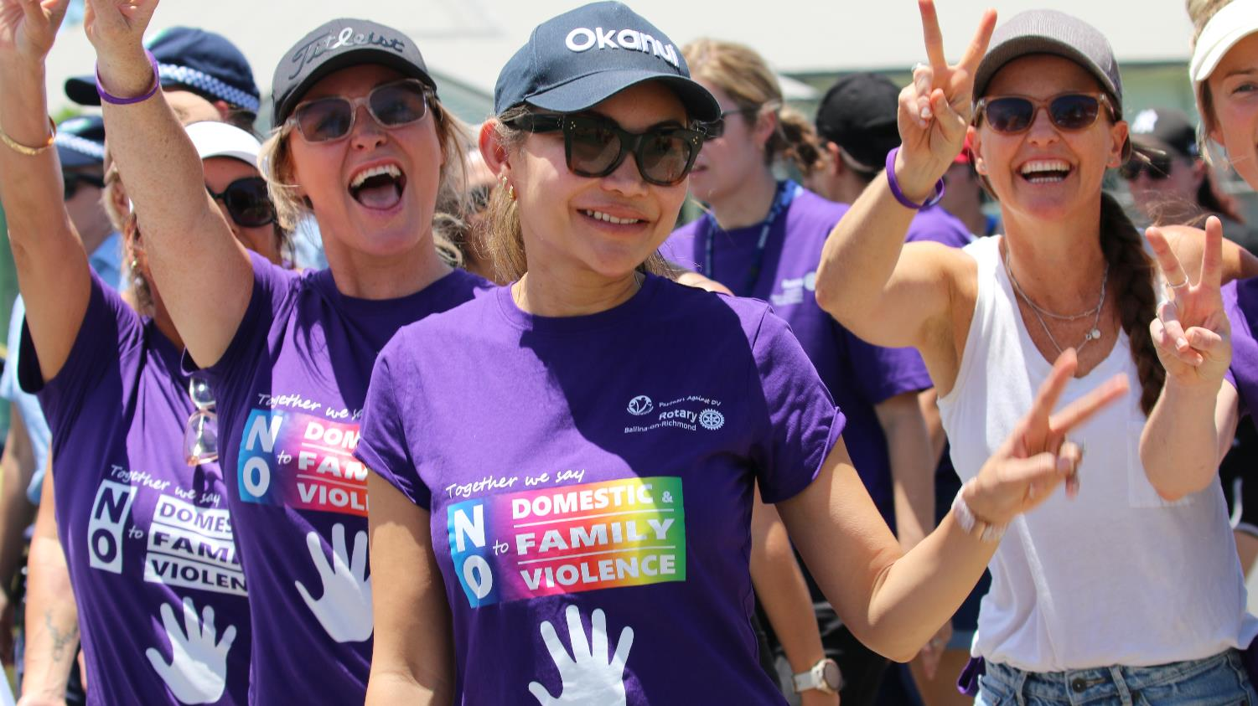
Notes:
Our Rotary approved Purple Shirts are wearable advocacy

Slide 12

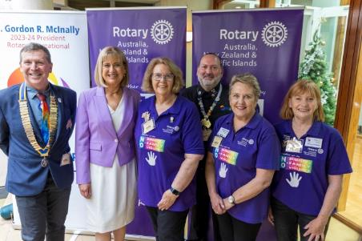
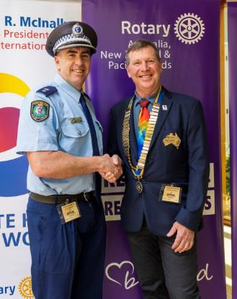
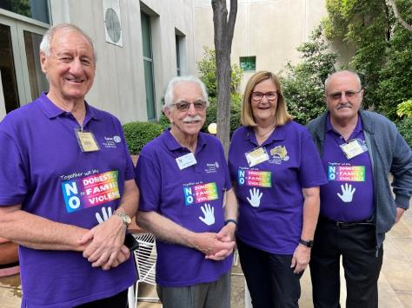
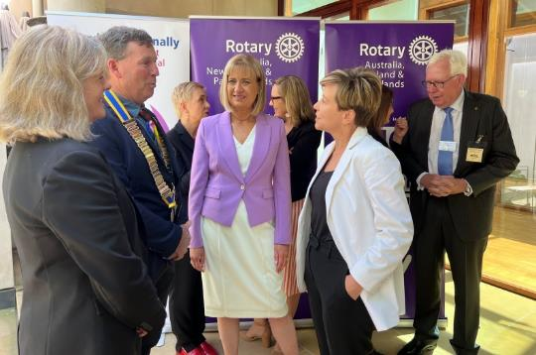
Launch at Parliament House
Canberra
Notes:
In November last year Rotary launched this campaign at Parliament House Canberra. This campaign has Tri-partisan support, is supported by the commonwealth D&FV Commissioner and has formed partnerships both state wide and nationally. This is the first time in Australia that Rotary has launched a campaign in the national capital.

Slide 13
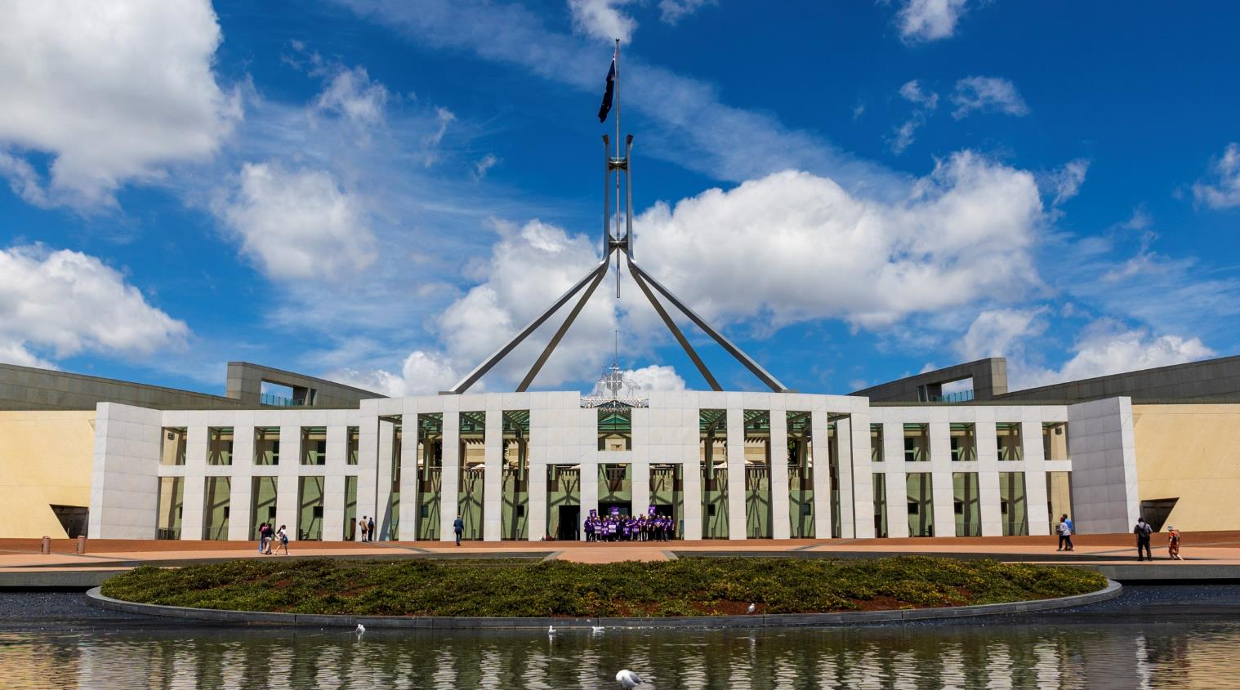
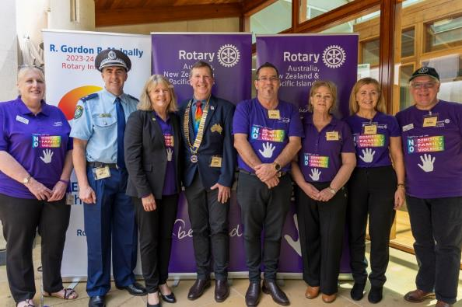
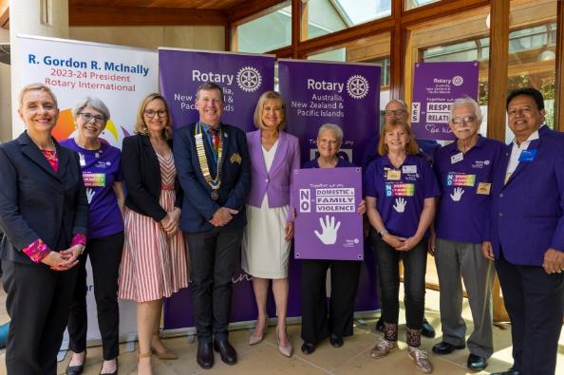

Slide 14
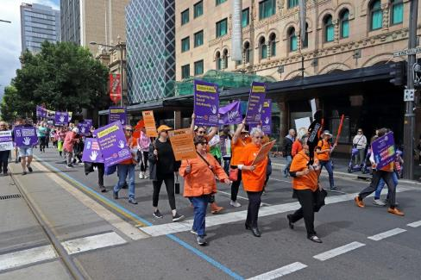
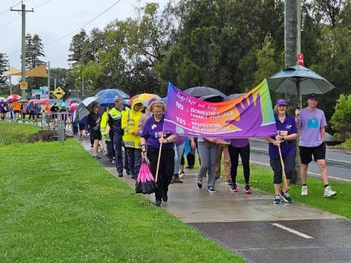
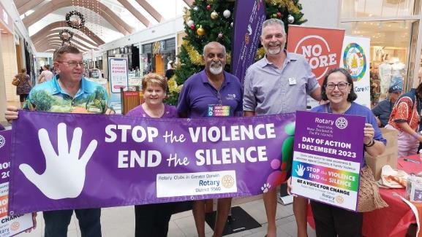
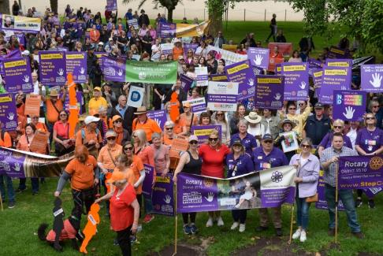
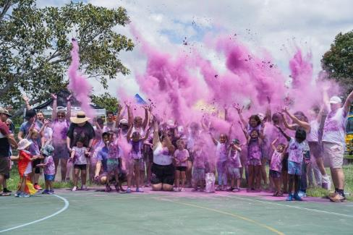
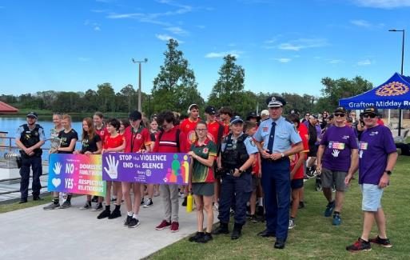
ZONE 8 Domestic & Family Violence Events Nov-Dec 2023
Notes:
Last year during the 16 days of activism we had Rotary clubs involved in or organised 110 activities around Australia. Photos show Brisbane, Adelaide, Wollongong, Darwin, Gold Coast and Grafton

Slide 15
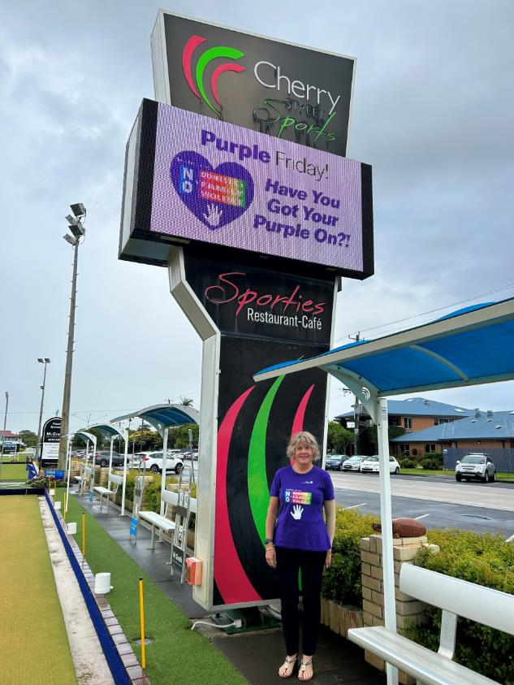
Purple Friday
Over 90 Businesses wearing dual branded shirts
every Friday.
Including;
Ballina Council
Ballina Primary & Secondary Schools, Day Care Centres
Registered Clubs on Northern Rivers
Retail Shops – Best & Less, IGA, Foodworks
Hospitality, Motels, Ramada
Professional Offices, lawyers,
Various Trades
Creating Impact
Increasing our Relevance
Confirming our Identity
Notes:
Purple Friday has helped lift this campaign to the next level. During the Christmas New Year period of 2022 a local Licenced Sports club ‘Cherry St Sports’ asked our Rotary club is their staff could wear our Rotary branded Purple Shirts over the Christmas New year period to help raise awareness of D&FV. Unfortunately on the 1sr of January 2023 Ballina had the first D&FV related death and the community very much come together with their grief and disbelief of this happening in our CBD. Our Rotary club and the management of the Sports club then met and we discussed what we could do to raise more awareness, let those experiencing D&FV know that they are supported and believed. We began a social media blitz offering 1000 free shirts to local businesses that would like to be part of our Purple Friday Campaign (each business would wear these shirts every Friday) In 2 weeks we had 80 businesses sign up, we now have close to 100 businesses which includes our local High School with 80 staff and 2 Primary Schools. This is Public Image, Impact and community engagement at its best. Our Rotary club now helps subsidise shirts for new businesses that wish to participate.

Slide 16
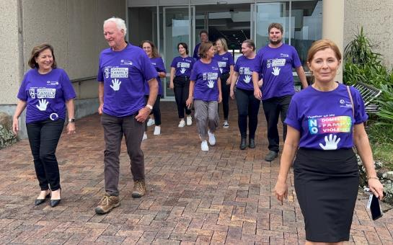
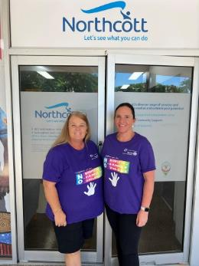
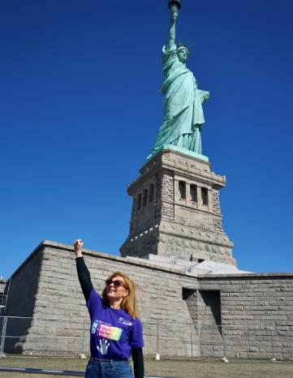
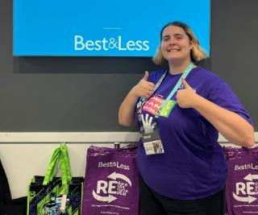
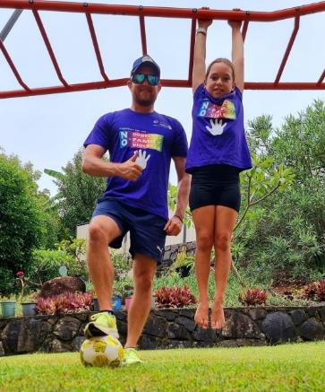
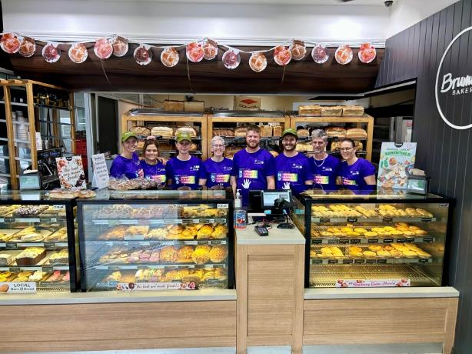
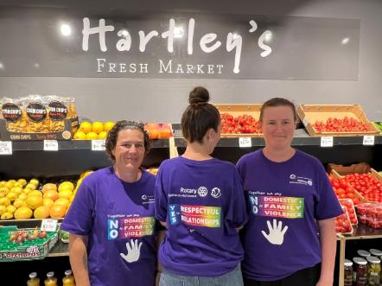
Notes:
Local businesses participating in Purple Friday

Slide 17
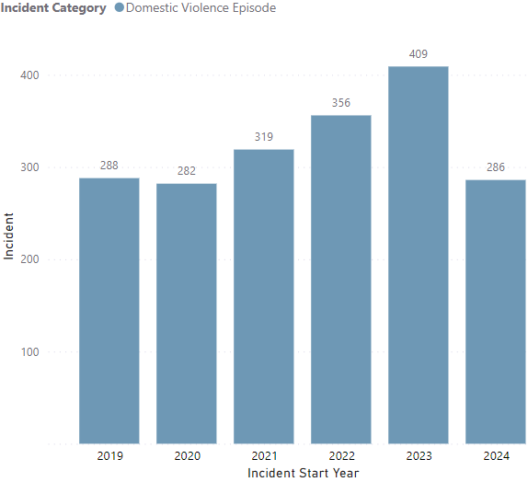
Reported Domestic and Family Violence Episodes Ballina NSW

Slide 18
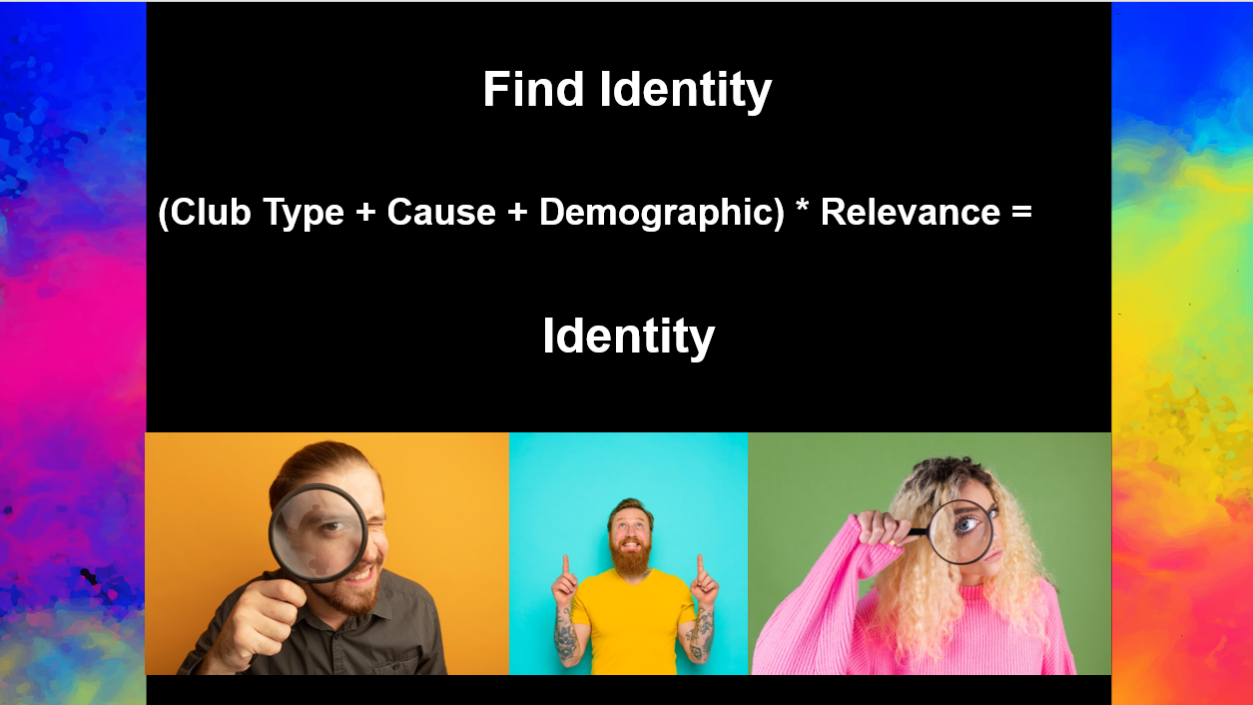

Slide 19


Slide 20

Notes:
Be brave, we can continue doing what we have always done or we can adapt and connect with what is relevant in our towns and cities. Our youth connect with causes related to the environment or social justice. Take a risk, what do you have to loose.

