Slide 1


Adopting Best Practice
Learning from what works rather than reinventing the (Rotary) wheel
Simone Collins
Zone 8 Best Practice Information &
Website Team Leader

Slide 2
What is best practice?

Slide 3
What is best practice?
a procedure that has been shown by research and experience to produce optimal results and that is established or proposed as a standard suitable for widespread adoption

Slide 4
What could we apply best practice to in Rotary?

Slide 5
What could we apply best practice to in Rotary?
How we market ourselves
How we conduct training – starting with new member orientation
How we communicate
How we make our volunteers feel valued
How we conduct our projects and events, from planning through to implementation and evaluation
How we run our clubs administratively
… every aspect of our operations!

Slide 6

Let’s talk about a few examples

Slide 7

1. New member orientation

Slide 8
New member orientation
Induction pack
What do you hand out to prospective members to ensure they are clear on their obligations?
Relationship building
Assign a Mentor & help them find a way to get active
Use a Buddy system
Mix up seating at meetings
Orientation activities
Fireside chats
Red badge program
What do you give them during their induction so that they know what their expectations and opportunities are?

Slide 9
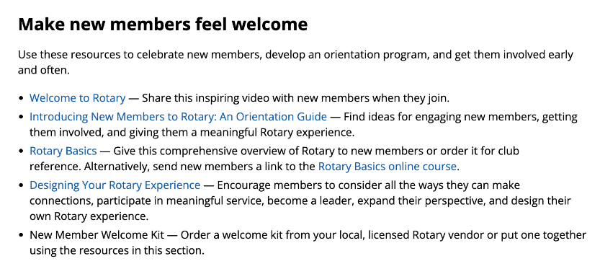
Provide useful introductory information
Induction pack
  From https://my.rotary.org/en/learning-reference/learn-topic/membership

Slide 10
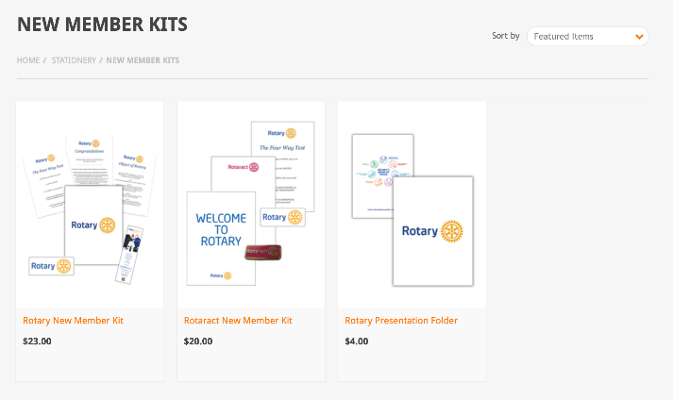
New member kit ideas
Induction pack
RDU Supplies: https://rdusupplies.com.au/certificates/new-member-kits/

Slide 11
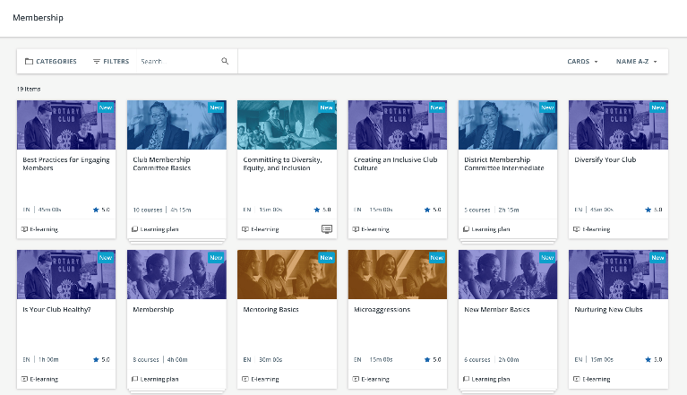
Help build relationships amongst members
Relationship building
  Assign a Mentor & help them find a way to get active
  Use a Buddy system
  Mix up seating at meetings

Slide 12

Dedicated orientation programs
Orientation activities
  Fireside chats
  Red badge program

Slide 13

2. Communication

Slide 14
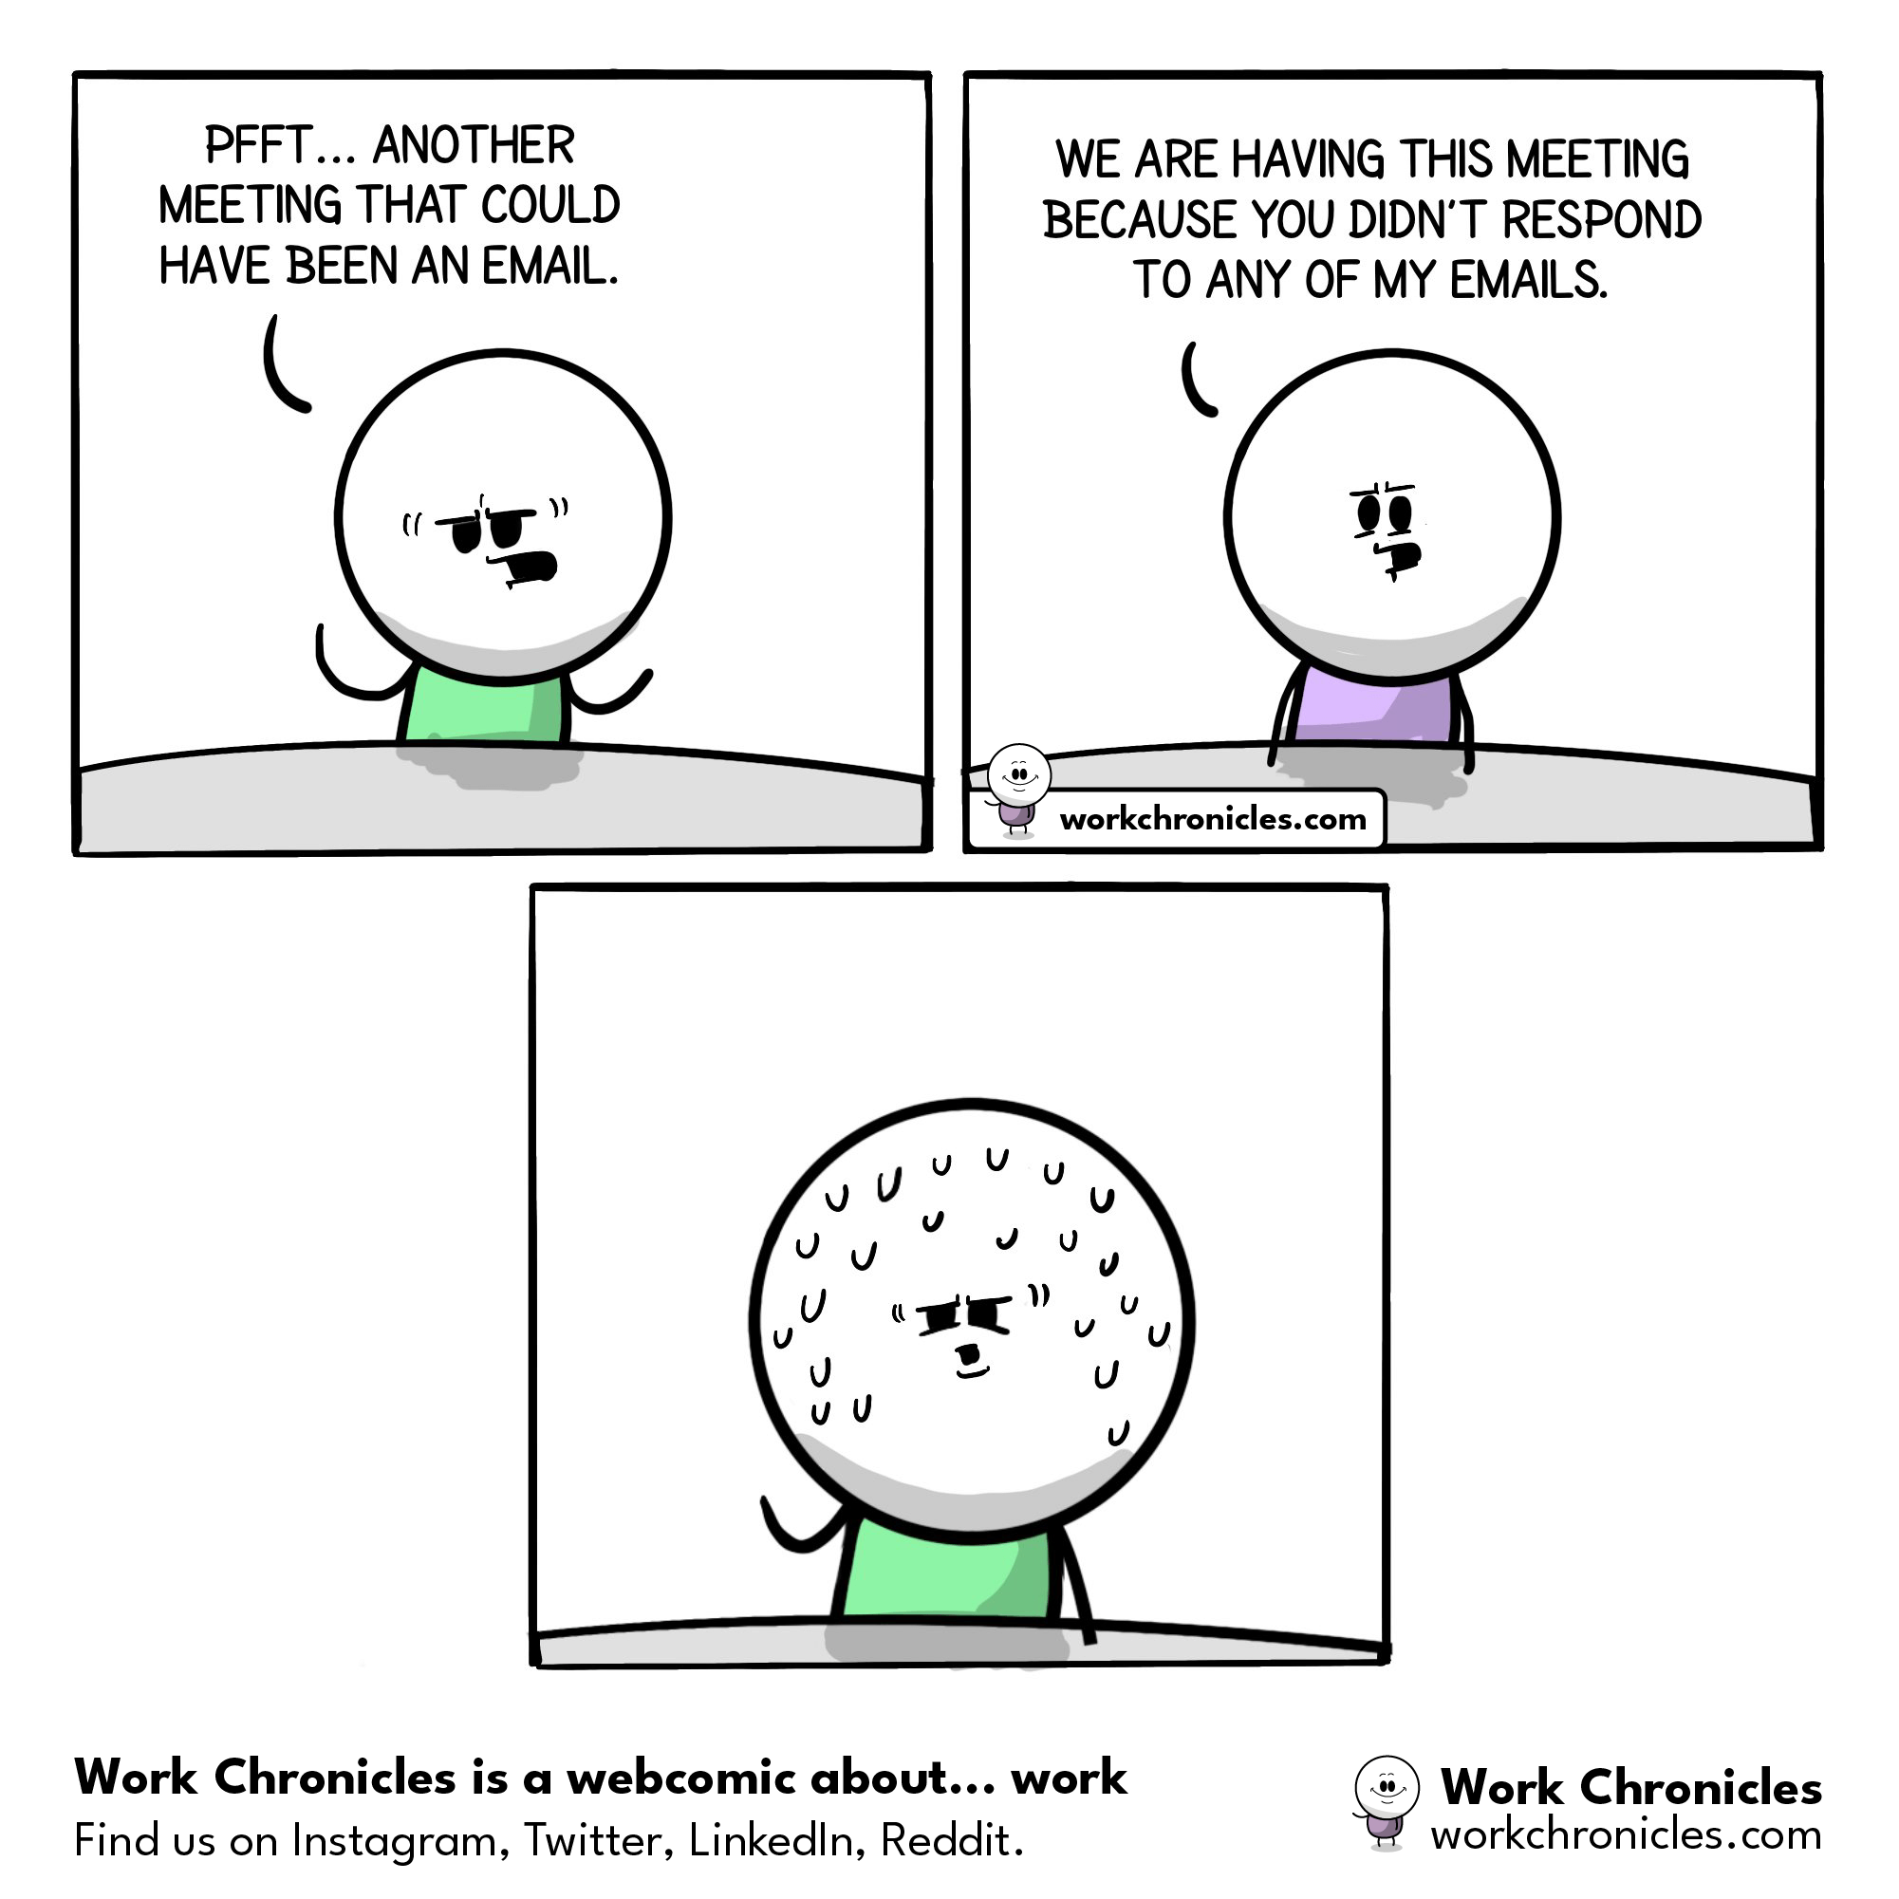
Meeting or email?

Slide 15
Effective communication without bombarding with unnecessary information
Limit emails
Consider a concise weekly / fortnightly newsletter
Up to date website
Up to date social media

Slide 16
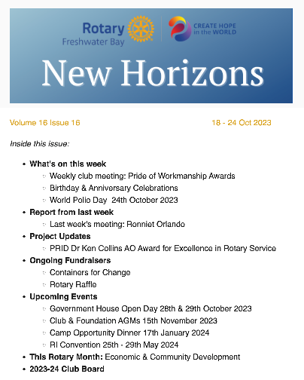
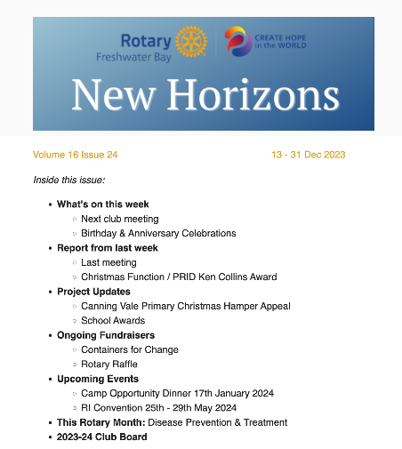
Sample newsletter

Slide 17
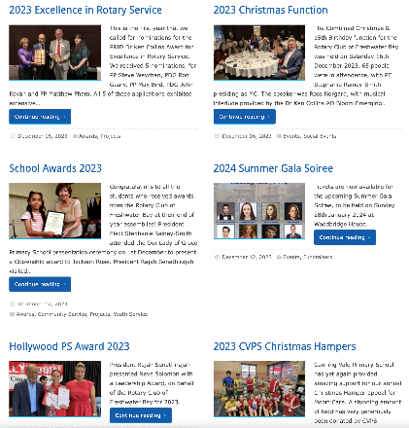
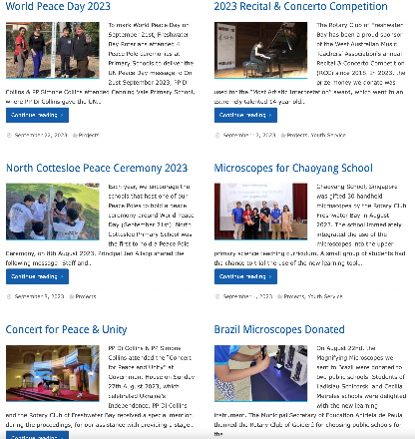
Blog posts on website

Slide 18

Best Practice Toolkits

Slide 19
Coming soon!
Case Studies
Press Kits
Customisable templates

Slide 20
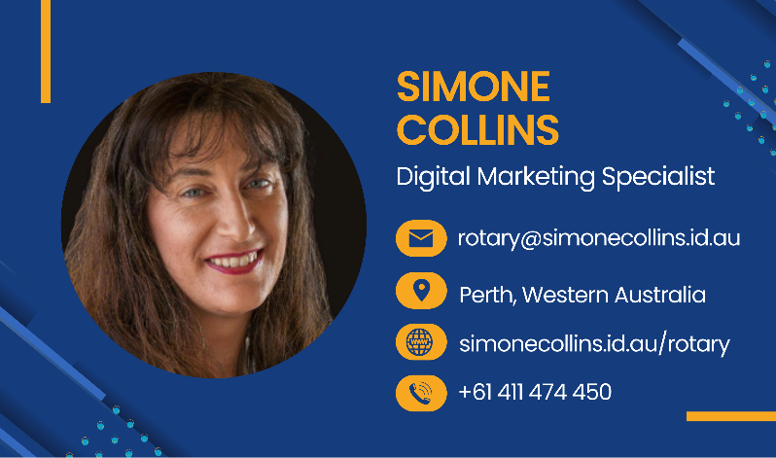
Feel free to get in touch!

