Slide 1

MEMBERSHIP
How to recruit new members

Slide 2
WHAT IS THE BEST WAY TO FIND A NEW MEMBER?

Slide 3
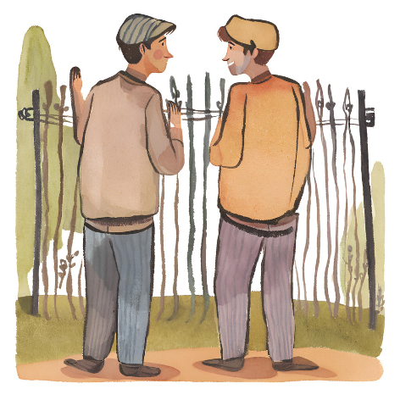
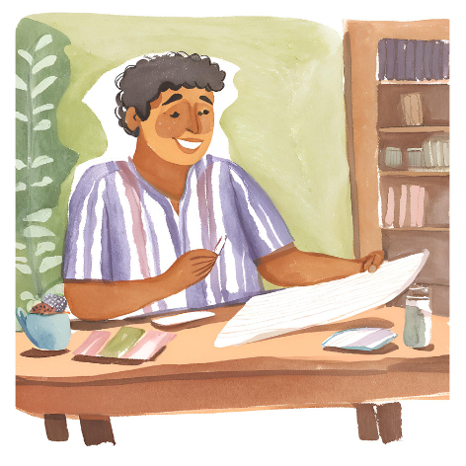
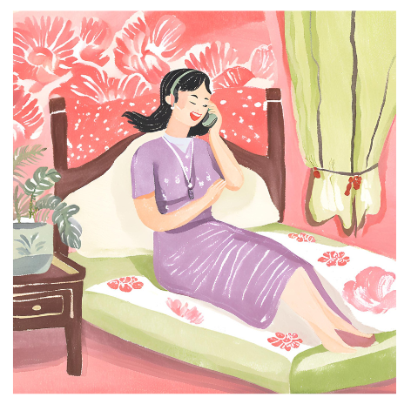
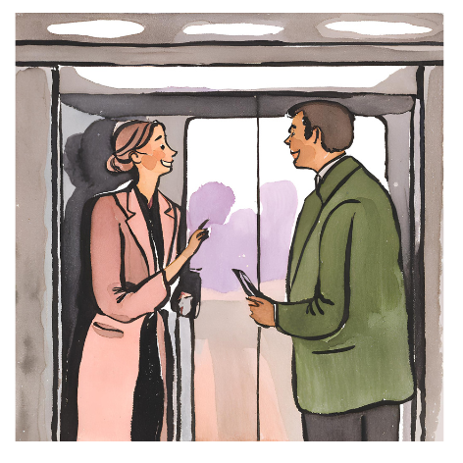

Slide 4
REJECTION!

Slide 5
ROTARY
INFORMATION
NIGHT

Slide 6

PICK A DATE

Slide 7

Butcher
Neighbour
Farmer
Electrician
Accountant
Boss
Best friend
Son or Daughter

Slide 8


Slide 9
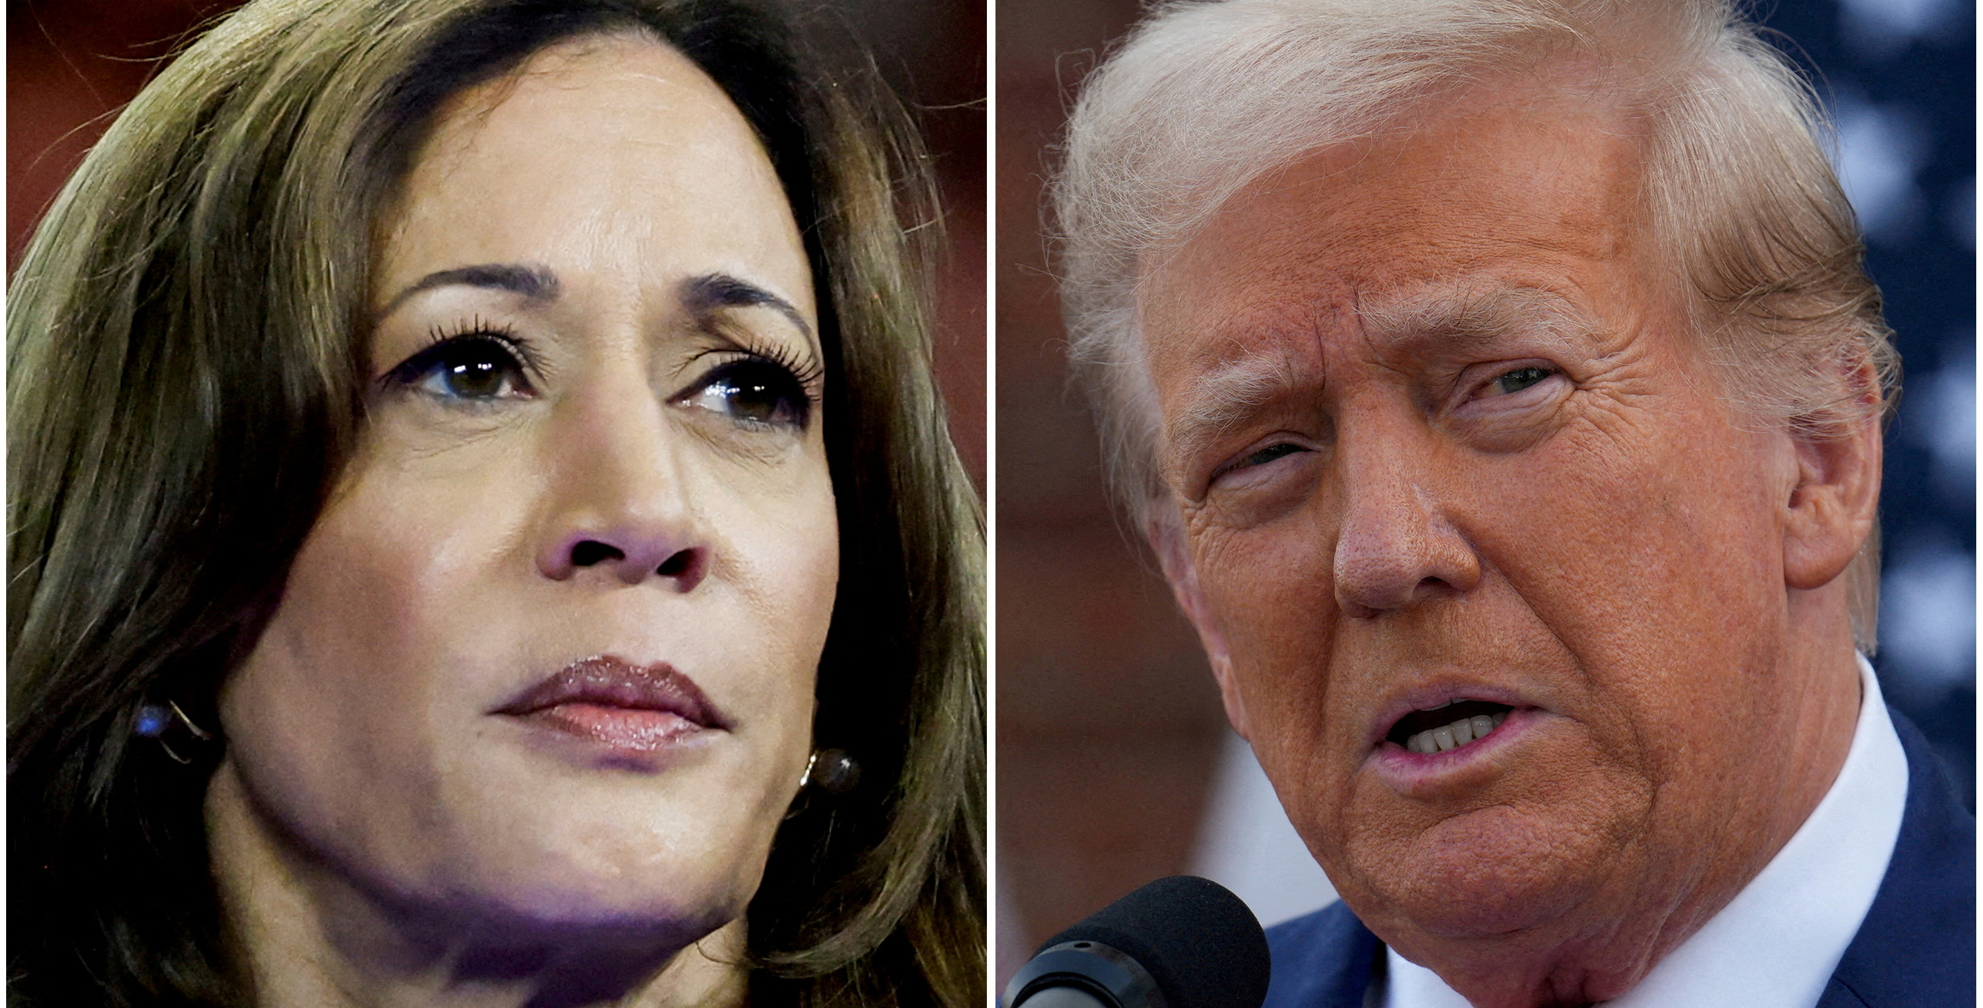
Send a letter from the president!

Slide 10
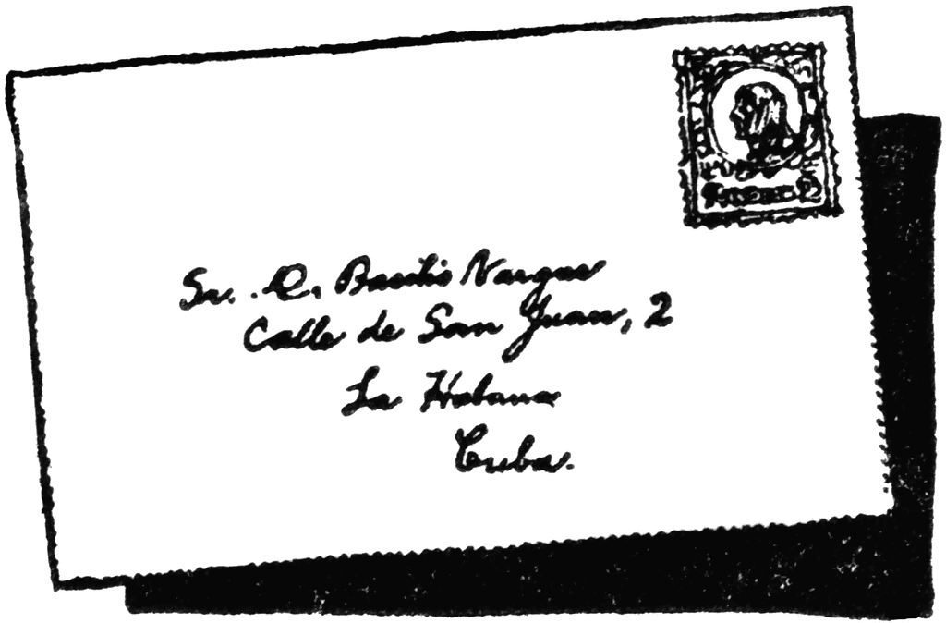
Letter
Preferably posted – snail mail!
Hand-addressed with a stamp

Slide 11
Dear [Handwritten Recipient's Name],
I hope this message finds you well. A respected member of our Rotary Club has recommended you as a business leader and a valued contributor to our community. We would be delighted to invite you to a relaxed evening with like-minded individuals, where you can learn about the impactful activities of Rotary International and our local Rotary Club.
Rotary has a unique role in the world as a non-governmental, non-religious, non-profit, and non-political organisation, and it has the potential to become one of the most significant forces for good in history. We would love for you to discover what we are accomplishing in the [XXX] community and beyond.
Join us on [Date] at [Location] at 6:30 PM for an engaging evening. We’ll have wine and light refreshments available for you to enjoy.
Please let me know if you can attend by calling me at [Your Phone Number] or emailing me at [Your Email Address]. Feel free to bring your partner along as well!
If you cannot join us at this time, please let me know, and I would be happy to arrange another opportunity for you to connect with us.
We sincerely hope you can join us as our guests, and I look forward to getting to know you better.
Warm regards,
[Your Name]
President, Rotary Club of XXXX

Slide 12


Slide 13
Seated Dinner
Stand-up cocktail party
Set Menu
Finger Food and Drinks
Special Guest Speaker
All short talks are about Rotary
Lots of Rotary Formalities

Slide 14


Slide 15

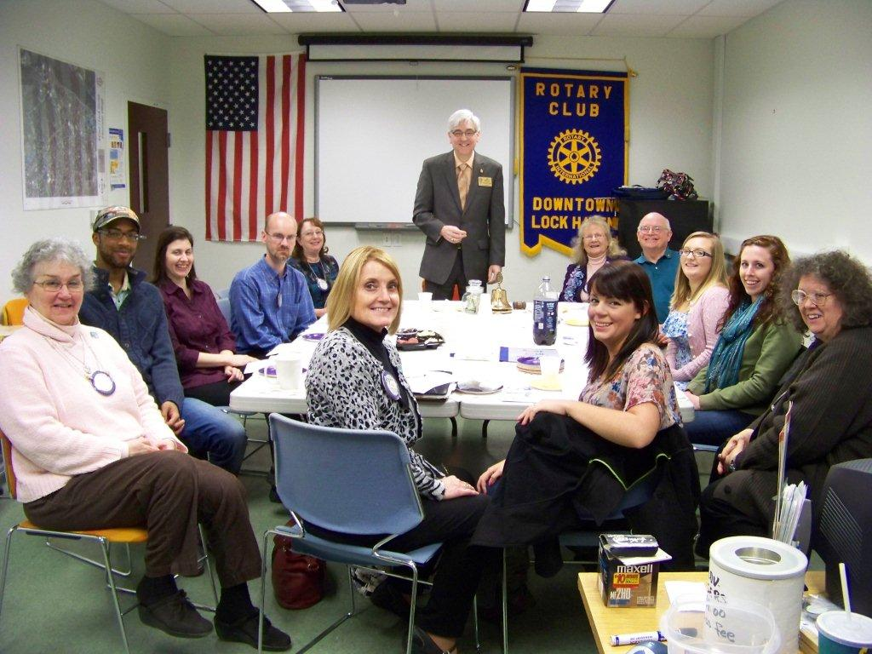

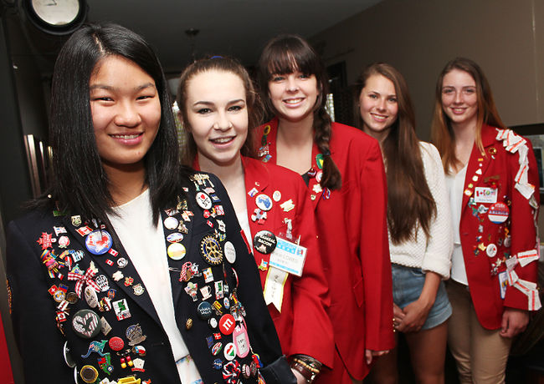
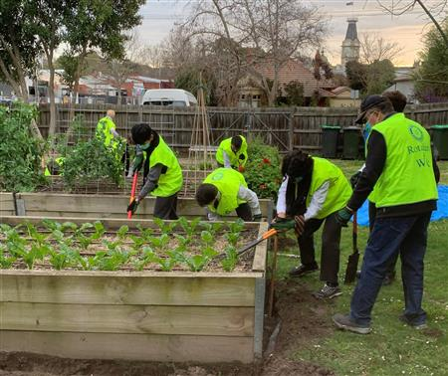

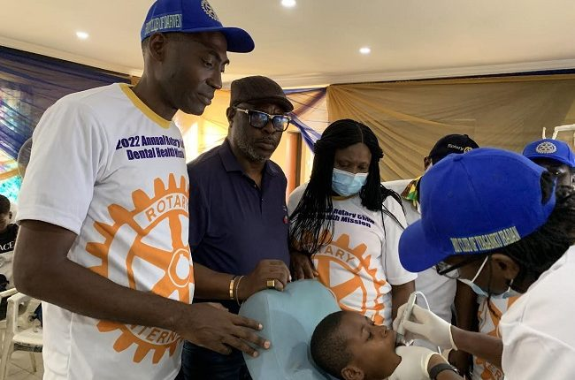
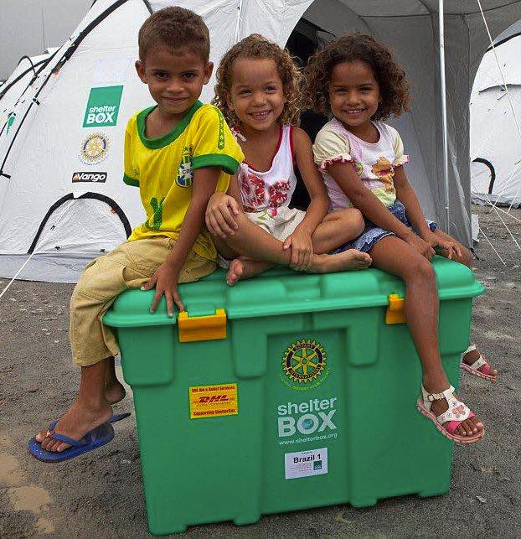

Slide 16

DO NOT MENTION FUNDRAISING

Slide 17
BE HONEST
HOW MUCH DOES IT COST?
CAN I PAY MONTHLY?
HOW OFTEN DO I HAVE TO COME TO MEETINGS?
I WORK AT WEEKENDS SO WHAT IF I CAN’T HELP AT THE MARKET?
I HAVE A LITTLE BABY. CAN I BRING HER?
I WORK OVERSEAS A LOT. DOES THAT MATTER IF I MISS MEETINGS?

Slide 18


DON’T LET THEM LEAVE EMPTY HANDED
Collect their phone number

Slide 19
THE NEXT DAY

Slide 20
FOLLOW UP

